Slide 1
REGENTS Exam Topic Analysis Month/Year: _________
Topic | Question #s from this Exam | Total Questions
Scientific Method & Inquiry
Lab (Skills, Tools, Technology, Safety)
Life Processes & Cells
Biochemistry
Body Systems / Homeostasis
Reproduction, Development Cell Division
Genetics & Biotechnology
Evolution
Ecology
Human Impact on the Environment

Slide 2
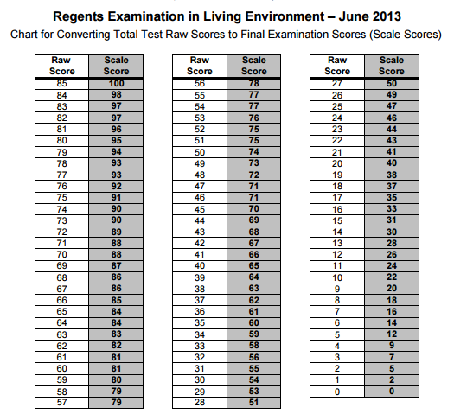

Slide 3
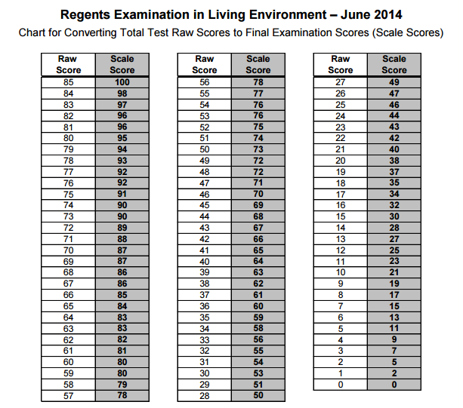

Slide 4
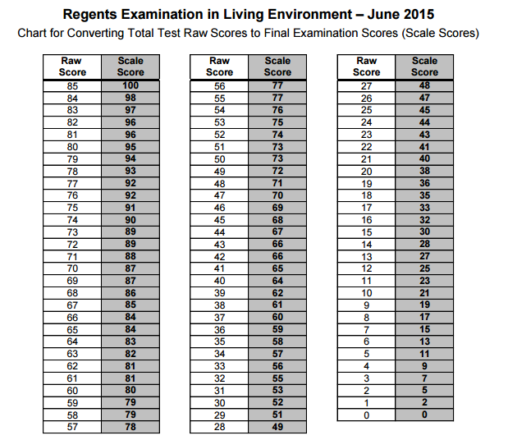

Slide 5
Topic Review 1
Scientific Method
Tools of the Biologist

Slide 6
Independent vs. Dependent Variables | Control vs. Experimental groups
Theory vs. Law | Validity
Scientific Method & Experimental Design

Slide 7
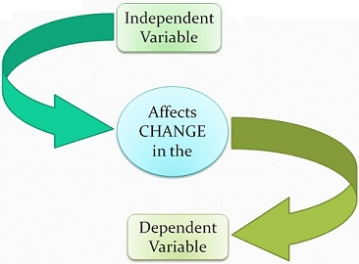
Independent vs. Dependent Variable
The Effect of INDEPENDENT on DEPENDENT
IV: factor intentionally changed by the researcher (Think “I” as in yourself)
  - x axis on graph
  - Ex. Amount of water
DV: factor measured / observed (“depends” on first variable)
  - y axis on graph
  - Ex. Height of plants

Slide 8
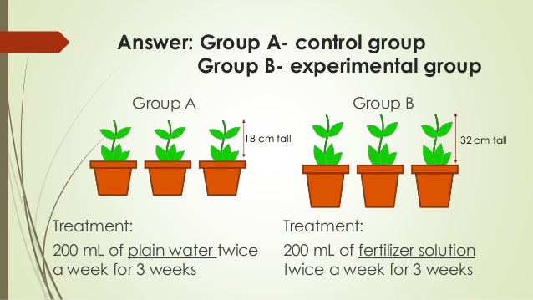
Control Vs. Experimental Groups
Control:
  remains in the original (normal) condition
  DOES NOT receive the treatment
Experimental:
  DOES receive the treatment
  may have more than one

Slide 9
Theory vs. Law
Theory:
  summarizes a hypothesis/hypotheses
  well supported with repeated testing
  can be disproven with new research
Law:
  generalizes a body of observations
  cannot be disproven

Slide 10

Validity
Large Sample size, multiple trials → more data
Only one independent variable is tested at a time
Other experimenters can repeat, yielding the same results!

Slide 11
Microscope | Separation Techniques
Indicators | Measurement
Lab Tools & Technologies

Slide 12
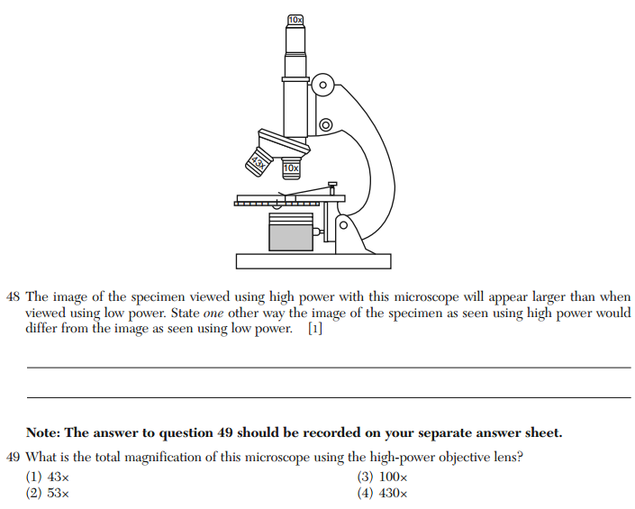
Microscope

Slide 13
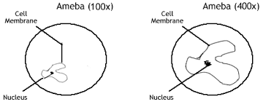
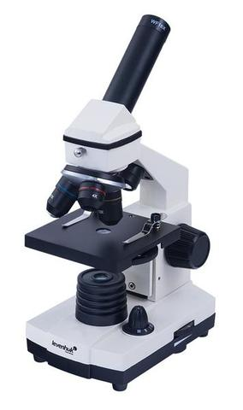
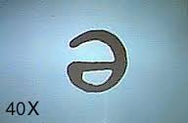
Microscope
High power – dark, narrowest field of view
Low power – bright, wider field of view
Total Magnification = ocular x objective
Image is inverted & reversed (upside down & backwards)
Moving a slide to the right makes specimen appear to move left under the scope!
Diaphragm – adjusts amount of light
Course Adjustment – never on high power!

Slide 14
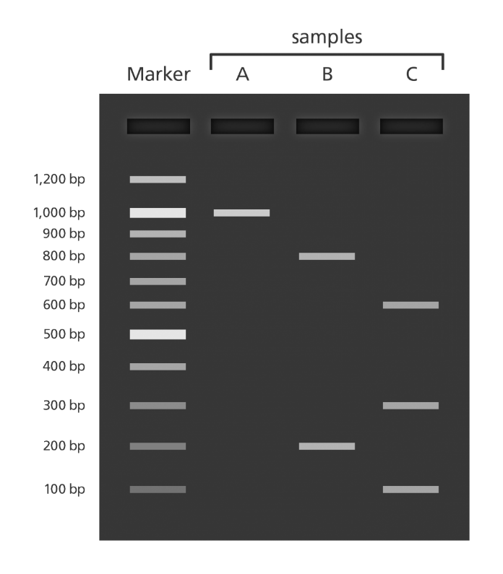
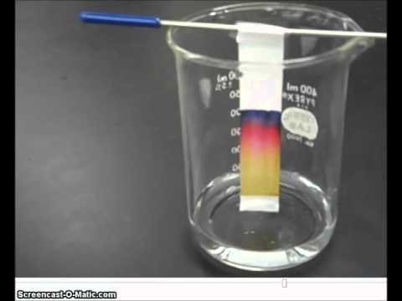
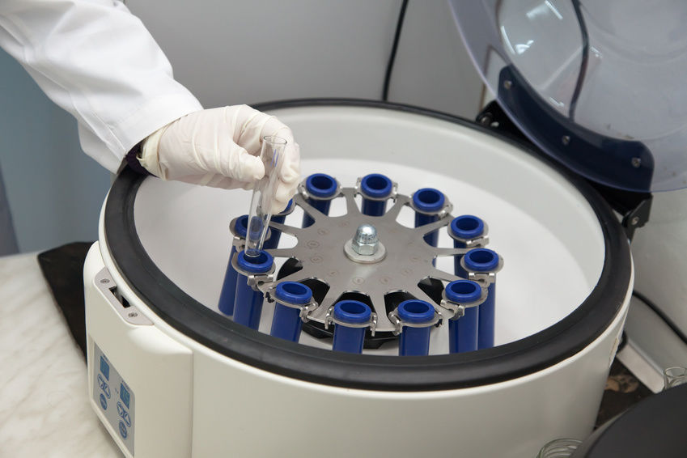
Separation Techniques
Chromatography
  filter paper and extract/inks – capillary action separates molecules by size
Gel Electrophoresis
  DNA fragments move through a gel by their size, due to electric current
Ultracentrifuge
  separates mixtures based on density
  Ex. Separating cell organelles or blood components

Slide 15
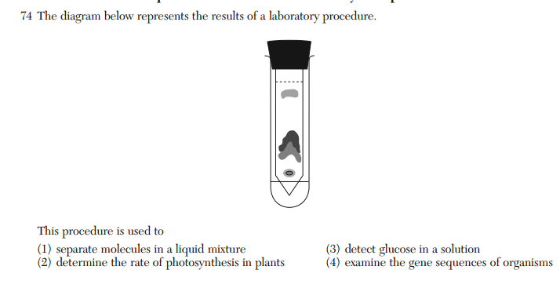

Slide 16
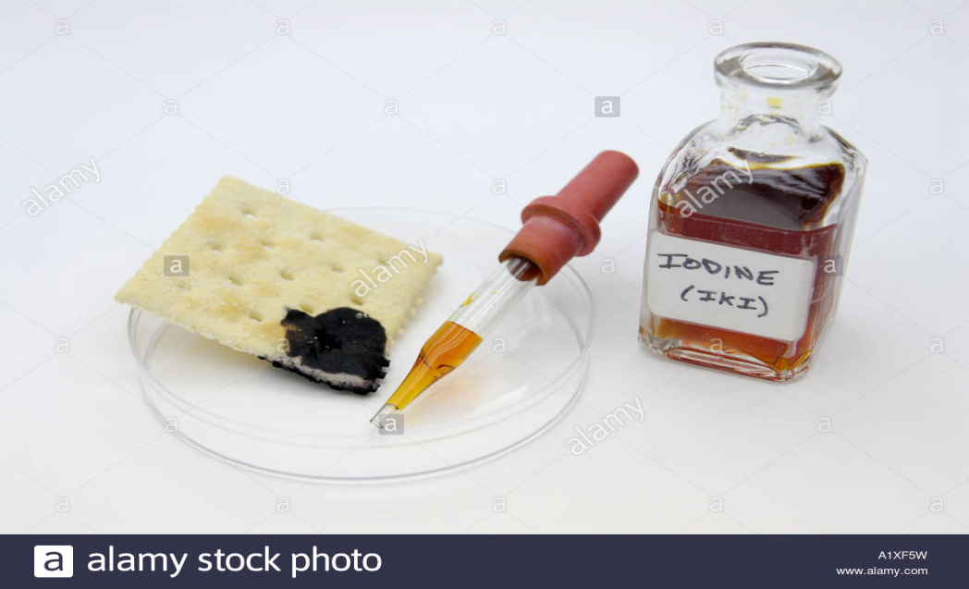
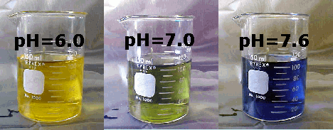
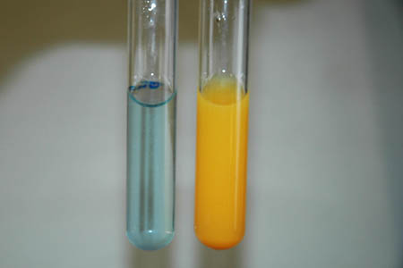
Indicators
Causes color change/bubbling if positive result
Lugol’s Iodine – starch (turns bluish-black)
Benedict’s Solution – glucose when heated (turns orange)
Bromthymol Blue – carbon dioxide (turns yellow)

Slide 17
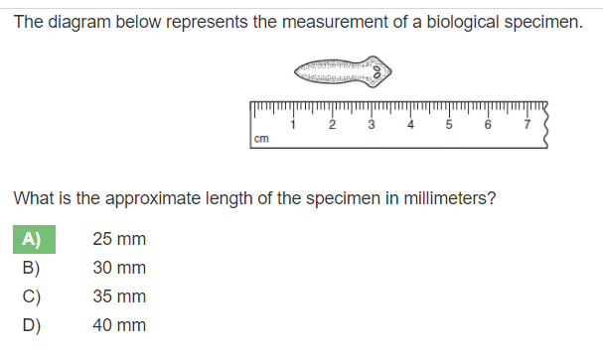
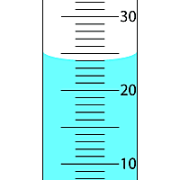
Measurement
1 centimeter = 10 millimeters
1 millimeter = 1000 micrometers
Pay attention to scale on apparatus (1s,2s,5s,etc.)
Volume of liquid is measured at lowest point called the meniscus

Slide 18
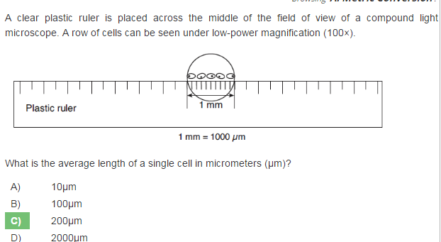

Slide 19
Topic Review 2
Life Processes
Cells

Slide 20
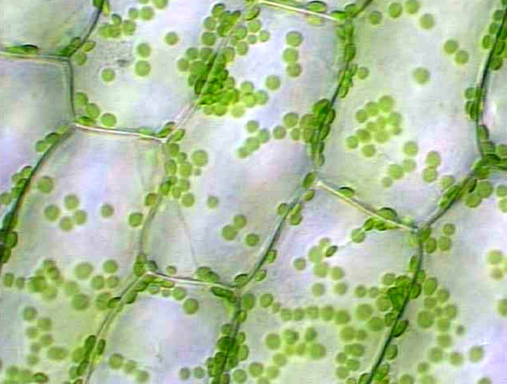
What type of cell is this? How do you know?

Slide 21
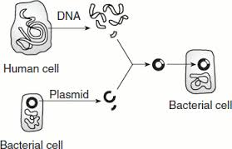
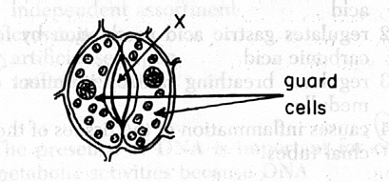
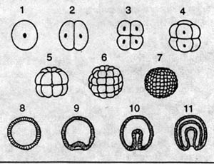
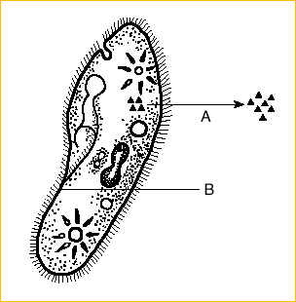
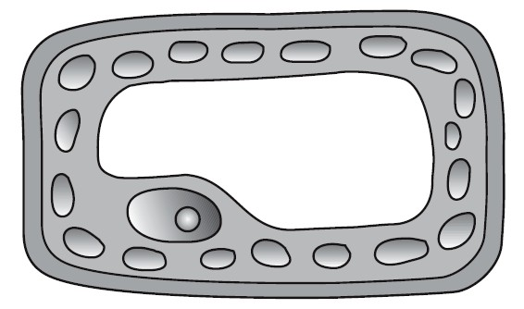
What type of cell is this?
How do you know?

Slide 22
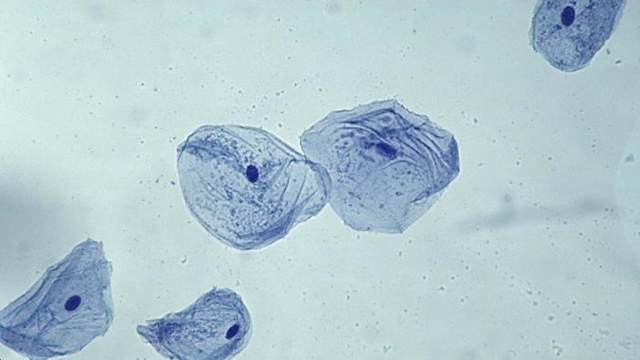
What type of cell is this? How do you know?

Slide 23
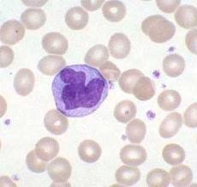
What type of cells are these? How do you know?

Slide 24
Life Processes & Cells
Draw a picture or write symbols in this box to summarize the topic.

Slide 25
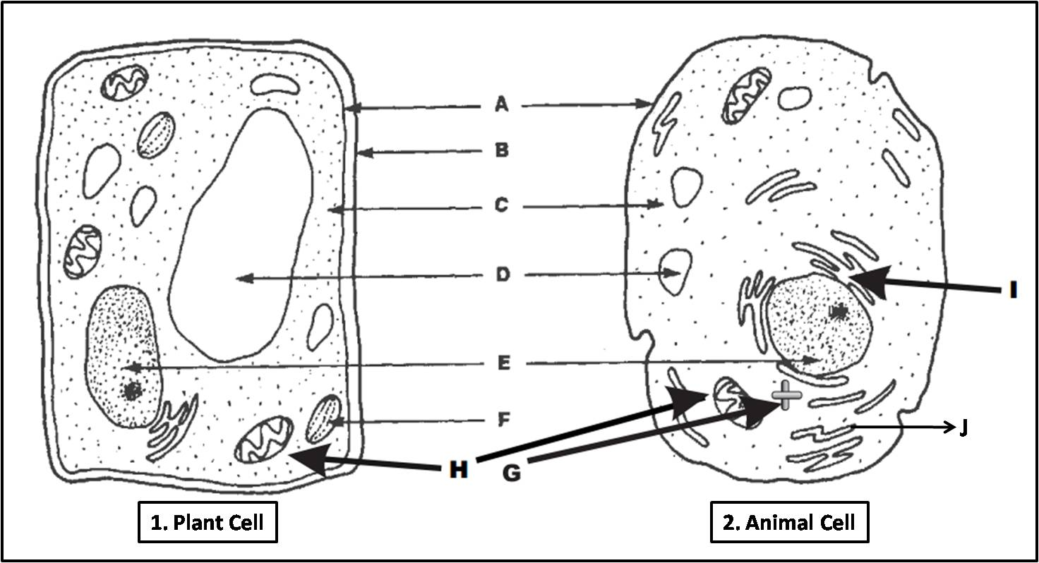

Slide 26
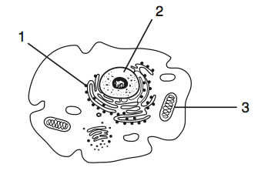
Animal Cell

Slide 27
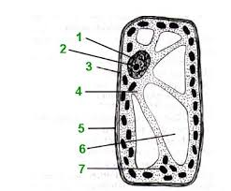
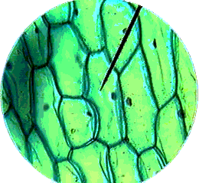
Plant Cell

Slide 28
List Key Words about the topic
8 essential life functions and associated processes
R
R
R
E
G
N
T
S
Regulation – ex. osmosis
Respiration – ex. aerobic cellular respiration, fermentation
Reproduction – ex. mitosis, meiosis
Excretion – ex. sweating, exhalation
Growth – ex. zygote cleavages, insect metamorphosis
Nutrition – ex. digestion (heterotrophic), photosynthesis
Transport – ex. circulation
Synthesis – ex. protein synthesis, photosynthesis

Slide 29
Paragraph: Summarize your understanding by using the key words you listed above to write a concise paragraph. Check off terms on the list as you use them. Circle the terms in your writing below.
EX. Try describing how these life processes interact in a cell maintaining homeostasis. Or, make a connection between life processes and cell organelles.
Nutrition provides the glucose needed for respiration to break down and release energy needed by cells.
Cell membranes are selectively permeable in order to be able to regulate which materials can enter a cell.

Slide 30
Topic Review 3
Biochemistry

Slide 31
Elements | Inorganic vs. Organic
Building Blocks | Enzymes
Basic Biochemistry

Slide 32
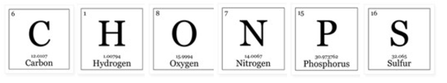
Elements
CHONPS (order of abundance in living things)
Smaller amounts of others including:
  Calcium, Iodine, Sodium, Potassium, Iron, Magnesium, etc.
Nitrogen – important for building amino acids/proteins
Cycle between living things and the environment through material cycles

Slide 33
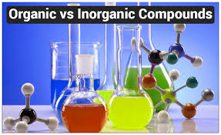
Inorganic vs. Organic
Inorganic: lacks combination of C & H (ex. salt, CO₂)
  H₂O is most important inorganic compound
  Salt (NaCl) is also important for chemical reactions
Organic: has both C & H (ex. Glucose, starch)
Bonds of organic molecules are energy rich
Energy is released when bonds are broken

Slide 34
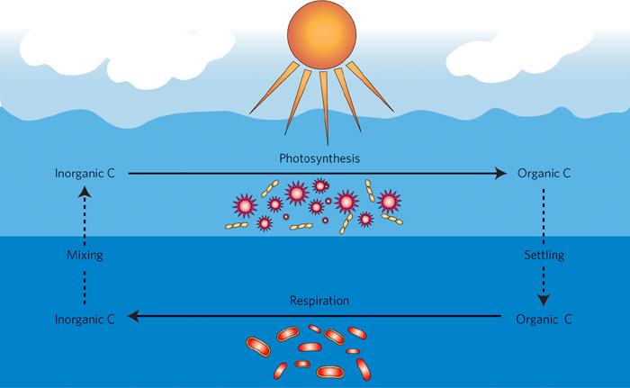

Slide 35
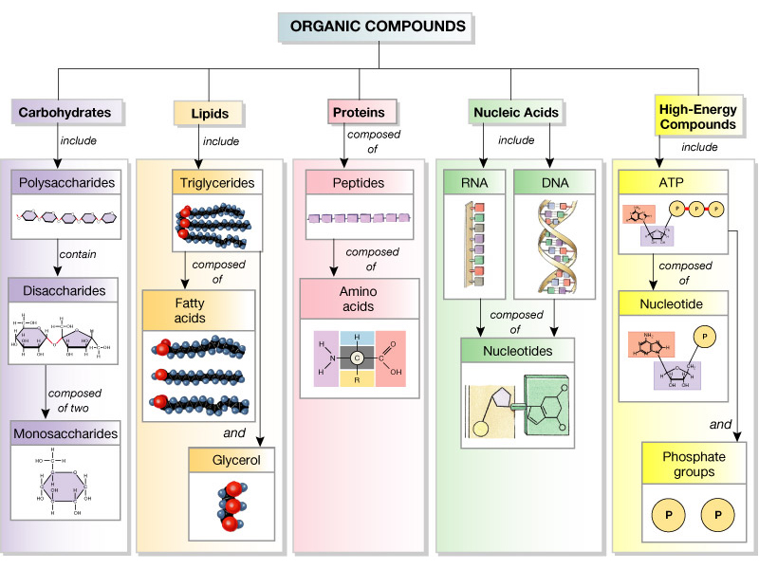

Slide 36
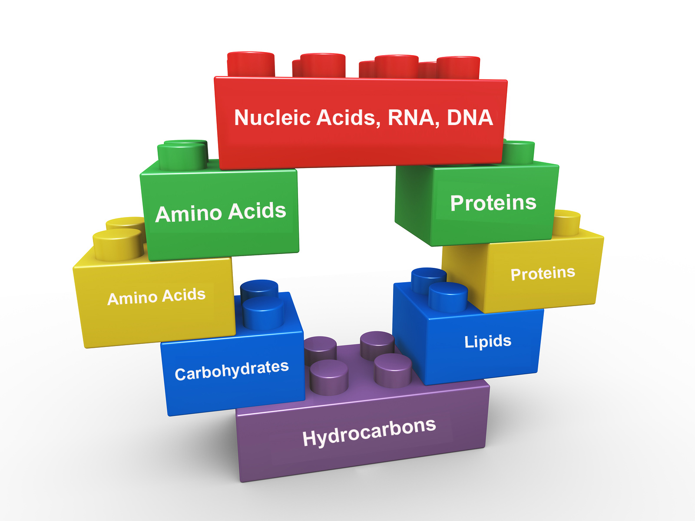
Building Blocks
Small (building blocks) Large
Amino acid Protein
Simple sugar (glucose) Starch
Nucleotide Nucleic Acid (DNA, RNA)
Glycerol & fatty acids Lipid
CAN diffuse Can NOT diffuse

Slide 37
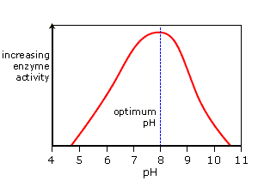
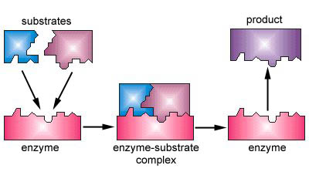
ENZYMES (proteins)
Organic/biological catalysts that control rate of chemical reactions
Fit only with specific shape substrate
Activity can be altered by pH level, temperature, or concentration
  Cold - activity slows but not denatured
  Too hot - activity slows and may be denatured

Slide 38
Aerobic Cellular Respiration | Anaerobic Respiration / Fermentation
Photosynthesis | Plant Adaptations
Biochemical Processes

Slide 39
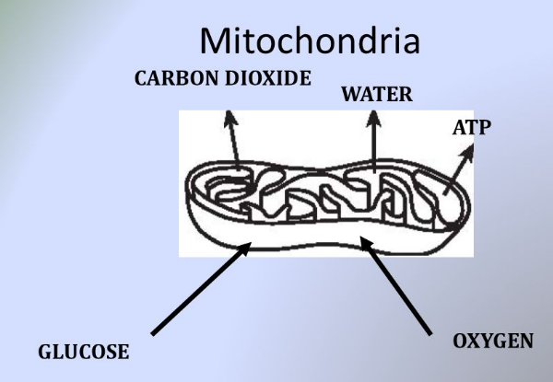
Aerobic Cell Respiration
uses oxygen to break down glucose
High energy yield
C6H12O6 + 6O2 → 6H2O + 6CO2 + 36ATP
Occurs in all animals, plants, algae and some bacteria
Main product
byproducts

Slide 40
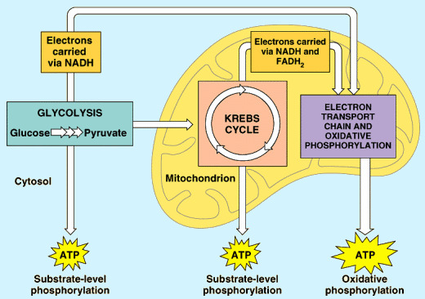

Slide 41
Anaerobic Cell Respiration / Fermentation
lower energy yield than aerobic
Lactic Acid Fermentation
Animals (as a last resort) and some bacteria
C6H12O6 → H2O + LACTIC ACID + 2ATP
Alcoholic Fermentation
Yeast and some bacteria
C₆H₁₂O₆ → H₂O + CO₂ + ALCOHOL + 2ATP

Slide 42
Photosynthesis
Performed by autotrophs / producers (ex. plants & algae)
Uses energy from the sun to convert inorganic compounds into energy rich organic compounds (food – glucose)
H2O + CO2 -----------------> C6H12O6 + O2
light
Main product
byproduct

Slide 43
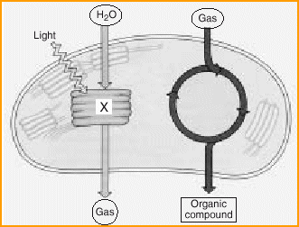
Photosynthesis

Slide 44
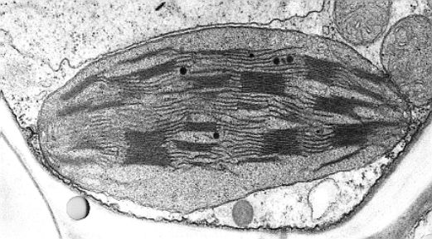
Chloroplast

Slide 45
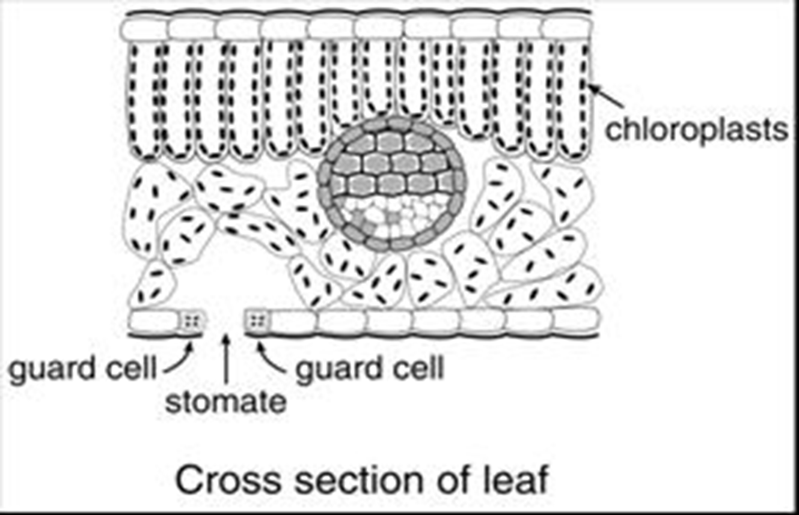

Slide 46
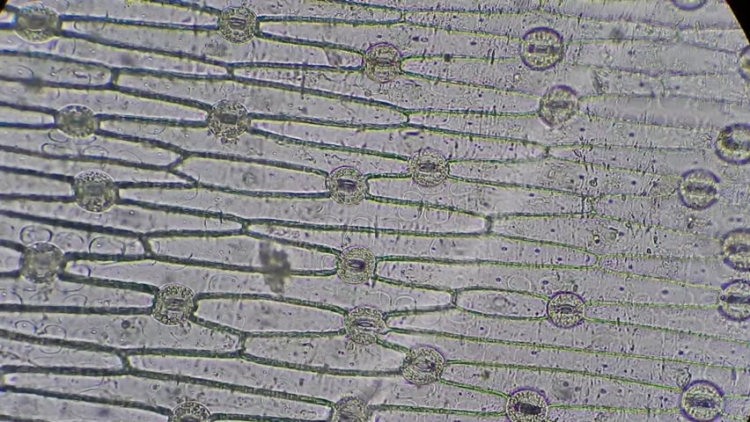
Lower Epidermis with Guard Cells

Slide 47
Plant Adaptations
Leaves
  flat & thin to absorb sunlight
  stomates (openings) allow for gas exchange
  guard cells control water loss from stomates (REGULATION of transpiration)
Roots/Stem
  water enters & moves upward by capillary action (xylem)
  minerals enter by Active TransPort (ATP)
Flower
  attracts pollinators for sexual reproduction

Slide 48
Topic Review 4
Homeostasis
Body Systems

Slide 49
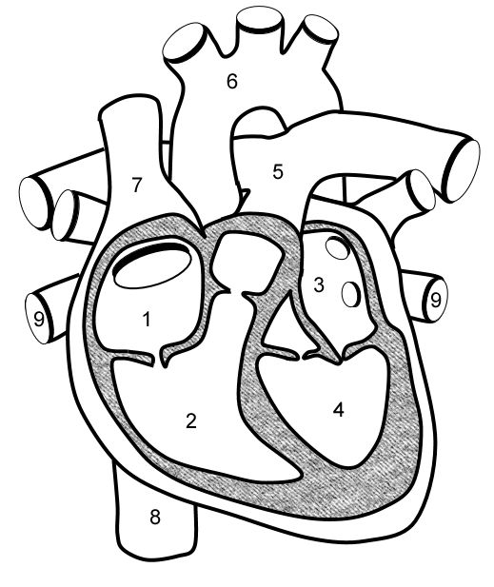
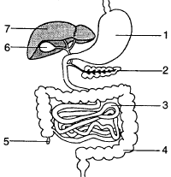
Circulatory / Cardiovascular
Digestive
System______________________
Life Process __________________
Nutrition
System______________________
Life Process __________________
Transport

Slide 50
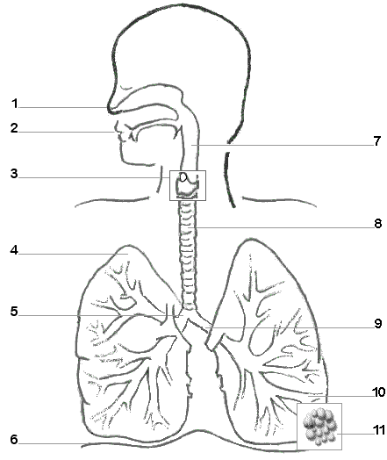
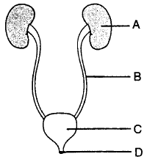
Respiratory
Urinary
System______________________
Life Process __________________
System______________________
Life Process __________________
Excretion, Respiration
Excretion

Slide 51
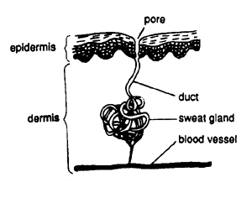
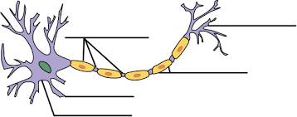
Nervous (a neuron)
Excretory (skin)
System______________________
Life Process __________________
System______________________
Life Process __________________
Regulation
Excretion, Regulation

Slide 52



Reproductive
Endocrine
System______________________
Life Process __________________
System______________________
Life Process __________________
Reproduction
Regulation, Growth, Reproduction

Slide 53
Body Systems BINGO Terms
AIDS
Allergy
Antibodies
Antigens
Cancer
Cells
Circulatory syst
Digestive syst
Effector
Endocrine syst
Engulf
Excretion
Gland
Glucagon
Growth
HIV
Homeostasis
Hormone
Immune syst
Insulin
Metabolism
Muscular syst
Negative feedback
Respiration
Respiratory syst
Response
Skeletal syst
Stimulus
Synthesis
Tissue
Transport
Urinary Syst
Vaccine
White blood cell
Nervous syst
Neuron
Neurotransmitter
Nutrition
Organ
Organelles
Pathogen
Positive feedback
Receptor
Regulation
Reproduction
Reproductive syst

Slide 54
Topic Review 5
Cell Division
Reproduction

Slide 55
Mitosis
Meiosis
asexual reproduction
sexual reproduction
ex. skin cells, zygote divisions
DNA must replicate first
ex. gamete production
2 daughter cells
Needed in human reproduction & development
4 daughter cells
diploid (2n)
haploid (n)
no crossing over
crossing over occurs
cell division
genetically identical
genetically varied

Slide 56
Directions: Write a paragraph using each of the following terms. Be concise. Cross out each term on the list as you use it & circle it in your paragraph. Use as few sentences as possible!
- meiosis, egg, ovary, ovulation, sperm, testes, fertilization, zygote, genetic recombination, fallopian tube, cleavage, mitosis, differentiation, implantation, uterus, embryo, fetus, placenta, diffusion, umbilical cord

Slide 57
Meiosis produces gametes (egg & sperm). Sperm are made in the testes of a male and eggs are made in the ovary of a female. After ovulation, when the egg is released, the egg and sperm fuse in the fallopian tube during fertilization. This newly formed zygote has undergone genetic recombination receiving half of its DNA from each parent. The first mitotic cell divisions, called cleavage, allow the zygote to grow and make more cells. The embryo embeds itself into the nutrient rich uterus lining during implantation. The cells will become specialized forming nerve cells, blood cells, etc. during differentiation. After 8 weeks of development it is called a fetus. A placenta grows attached to the uterus at one end and the umbilical cord at the other end, allowing nutrients and wastes to pass between mother and fetus by diffusion across the capillary walls.

Slide 58
Topic Review 6
Genetics
Biotechnology

Slide 59
Top TEN Facts - Genetics & Biotechnology
10.
Chromosomes are long, tightly wrapped strands of DNA that contain genes which code for building proteins.
9.
DNA is made of paired nucleotides (A with T, G with C) held together by weak hydrogen bonds.
The sequence of DNA’s code is copied into mRNA form (A pairs with U instead of T) during transcription in the nucleus.
8.
7.
mRNA is translated at the ribosome where the correct sequence of amino acids are linked together to form a protein.
6.
Mutations are changes in DNA that could cause the resulting protein to be misshapen and nonfunctional.

Slide 60
Top TEN Facts - Genetics & Biotechnology
5.
All cells contain an organism’s full genome but cells only express certain genes.
Gene expression can be affected by environmental factors.
4.
3.
Selective breeding involves choosing organisms to mate so that their offspring may have their desired traits.
Genetic engineering alters/changes genetic make up, creating new varieties of organisms for medicinal, agricultural, and environmental purposes. (ex. Insulin production)
2.
1.
Cloning is the process of producing a genetically identical copy of an organism/cell/gene.

Slide 61
Topic Review 7
Evolution

Slide 62

Evolution Crossword
beaks
extinct
homologous
vestigial
chimpanzee
speciation
common ancestor
cladogram
billion
competition

Slide 63

selection
adaptation
mutation
overproduction
finch
Beagle
fossil
Darwin

Slide 64
Topic Review 8
Ecology
Human Impact

Slide 65
Ecology Review
Level | Description | Example
1. Organism
2. Population
3. Community
4. Ecosystem
5. Biosphere
Level | Description | Example
1. Organism | an individual living thing | one white tailed deer
2. Population | All members of 1 species in an area | All the white tailed deer in a forest
3. Community | All living things in an area (many different species) | All the animals, plans, & microbes in the forest
4. Ecosystem | Both the living and nonliving parts of a specific habitat | the forest (including air, water, etc. & living things)
5. Biosphere | Portion of Earth where life exists | Land, sea, & air in all of Earth’s biomes

Slide 66
Fill in the diagram below with the Levels of Organization studied in Ecology. Use the terms from the table above.
organism
population
community
ecosystem
biosphere

Slide 67
living
nonliving
Biotic
plants
animals
Abiotic
temperature
moisture
Autotrophs
nonliving
producers
Heterotrophs
eating
consumers
They are the organisms that are able to take in energy from the sun and use it to produce organic compounds (glucose) which is a food source for other organisms.

Slide 68
herbivore
carnivore
omnivore
decomposer
primary consumer
secondary consumer
tertiary consumer
trophic levels
sun
Food web includes interconnected food chains

Slide 69
Tertiary consumer
ex. snake
Secondary consumers ex. frog
Primary consumers
Ex. grasshopper
Producers - ex. grass

Slide 70
Limiting factors such as food sources available, temperature, pH level, determine which organisms can survive in a habitat, keeping populations in check maintaining the carrying capacity.
Occurs when an ecosystem changes over time. Pioneer organisms are the 1st to appear and they modify the environment allowing for other organisms to survive and continue to modify the environment until a stable climax community is established.

Slide 71
Human Impact
Describe the difference between renewable and nonrenewable resources. Give examples.
Renewable – can be replenished, ex. Trees
Nonrenewable – finite, cannot be replenished, ex. Fossil fuels
Describe renewable energy sources.
Solar power – energy from the sun can be used for electricity
Wind power – energy from wind can be used for electricity
- unlimited, do not require fuel, do not produce CO₂ (greenhouse gasses)

Slide 72
Human Impact
List the benefits and threats to biodiversity
Benefits to Biodiversity | Threats to Biodiversity
Benefits to Biodiversity | Threats to Biodiversity
Conservation of resources Reforestation Shade farming/planting Wildlife & nature preserves Laws restricting hunting/fishing | Deforestation Overhunting/overfishing Use of biocides Global warming Deforestation/habitat destruction
Benefits to Biodiversity | Threats to Biodiversity
Conservation of resources Reforestation Shade farming/planting Wildlife & nature preserves Laws restricting hunting/fishing

Slide 73
Human Impact
Give examples of reduce, reuse, & recycle
Reduce
Turn off lights when leaving the room
Turn off water when brushing teeth
Reuse
Buy second hand goods instead of new
Reusable shopping bags, water bottles, etc.
Upcycle (find new a use for wastes)
Recycle
Place your paper, glass, plastic, metal wastes in recycling bins
Purchase goods made from recycled materials (ex. notebooks)

Slide 74
For the following topics, list the causes, effects, & remedies.
Problem | Cause | Effect | Remedy
Water Pollution | Chemicals, sewage, oil, pesticides, hot water | Reduces biodiversity, disrupts food chain | Use alternate energy (not oil), natural predator not biocides
Acid Rain | Sulfur dioxide & nitrogen oxide from factory emissions (burning fossil fuels) | Disrupts enzyme function in plants and aquatic life | Pass laws restricting emission levels
Global Warming | Excess CO2 from burning fossil fuels | Inc. temp melts ice, disrupts habitats, rising sea levels | Reduce fossil fuel use, use clean energy sources, plant more trees

Slide 75
Ozone Depletion | Chemicals called CFCs (chlorofluorocarbons) in refrigeration & air conditioning units | Increases UV radiation, mutations, skin cancer | Banned use of CFCs
Pesticides | Crops are destroyed by pests (insects/rodents) costing money | Decreases biodiversity, pollutes water supply, bioaccumulation of toxic chemicals up the food chain (highest conc. at top) | Use biological controls instead like a natural predator of the pest or spray hormones to attract & trap insects

Slide 76
Lab Review
State Labs
Lab Skills

