Slide 1
Boards Up! Regulation Review
Nervous System and Endocrine System

Slide 2
One function of an interneuron is to relay an impulse from a __________ to a ______________
A sensory neuron to a motor neuron

Slide 3
Name one function of the cerebrum
Personality, memory, behavior, thought, emotions, language, etc.

Slide 4
Name one hormone produced by the pituitary gland and its function
Examples: GSH- regulates the growth of long bones
TSH- stimulate thyroid gland
Prolactin- stimulates milk production

Slide 5
Name for something that causes an action or response
Stimulus

Slide 6
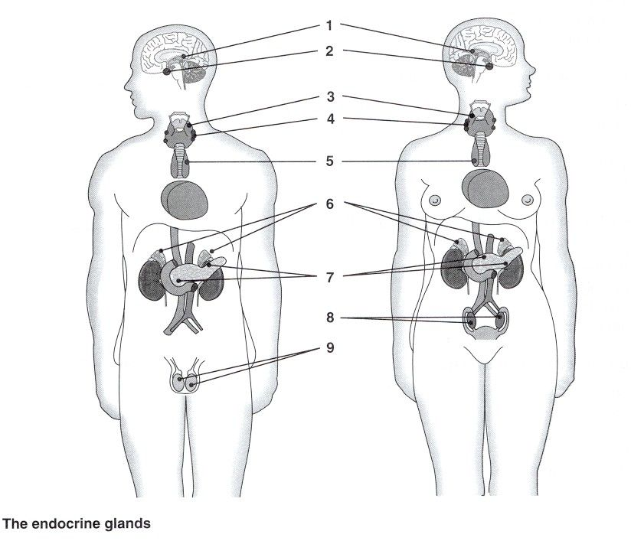
Identify glands 2, 6, & 7

Slide 7
Name for the fatty insulation that speeds up transmission of electrochemical messages
Myelin Sheath

Slide 8
Part of the neuron that releases chemical neurotransmitters into the synapse
Terminal Branch/Axon Terminal/Synaptic Knob

Slide 9
Part of the brain that links the nervous system to the endocrine system and responsible for the production of hormones
Hypothalamus

Slide 10
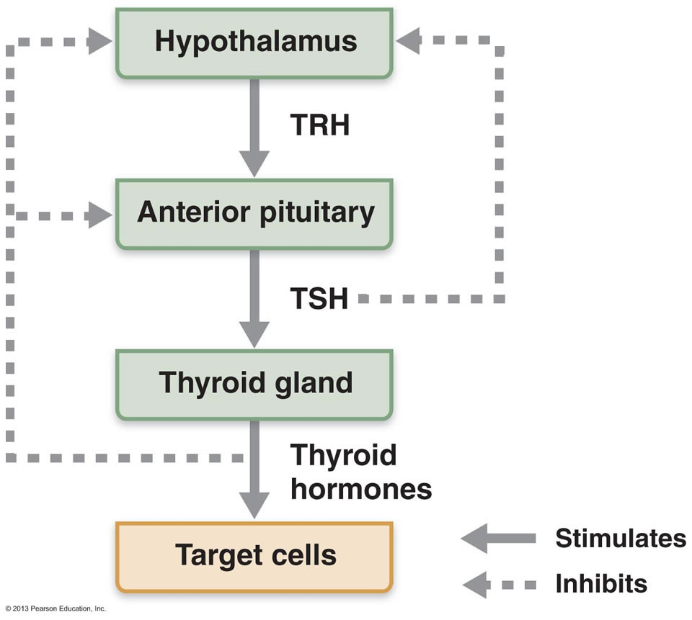
What do the dashed lines represent in this diagram?

Slide 11
Hormone responsible for decreasing blood-glucose levels
Insulin- attaches to glucose to bring it from the blood into cells!

Slide 12
Malfunction of the nervous system that is caused by a bacterium or a virus that causes inflammation of the membranes surrounding the CNS
Meningitis

Slide 13
Body system most closely associated with the production of regulatory chemicals by glands
Endocrine system

Slide 14
A mechanism in the body that helps maintain homeostasis (ex: causes a gland to stop the release of a hormone)
Negative feedback

Slide 15
What hormone regulates the rate of metabolism in the body?
Thyroxin

Slide 16
A disorder of the endocrine system that is caused by an undersecretion of thyroxin
Hypothyroidism

Slide 17
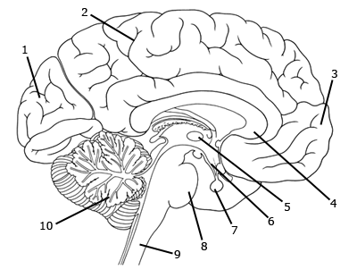
Which number represents the center for controlling balance and coordination?

Slide 18
Name of cells that have specifically shaped receptors for certain hormones
Target Cells

Slide 19
Hormone that increases the diameter of blood vessels, increases heartbeat and breathing rates
Adrenaline

Slide 20
Division of the nervous system that processes, interprets and stores information
Central Nervous System

Slide 21
Name of sacs that release neurotransmitters into the synapse
Vesicles

Slide 22
Division of the Peripheral Nervous System that handles voluntary control of body movement (ex: running)
Somatic

Slide 23
Part of the neuron that picks up signals from the previous neuron
Dendrite

Slide 24
Name one similarity between the nervous system and the endocrine system
Regulate responses to changes in the environment, both involve receptors to recognize specific signals, cells communicate, etc.

Slide 25
Write down the route of an impulse in a reflex arc
Stimulus→ receptor → sensory neuron→ interneuron → motor neuron→ effector →response

