Slide 1
Let’s Review!! Respiration and Photosynthesis

Slide 2
What are the three products of aerobic respiration?
Carbon Dioxide, Water and ATP energy

Slide 3
True or False: Animals respire and plants do not.
False

Slide 4
Aerobic respiration requires ________ + ________
Oxygen and Glucose

Slide 5
Anaerobic respiration produces _____ ATP
2

Slide 6
Yeast produce _______ as a product of anaerobic respiration whereas humans produce ________.
Alcohol, Lactic Acid

Slide 7
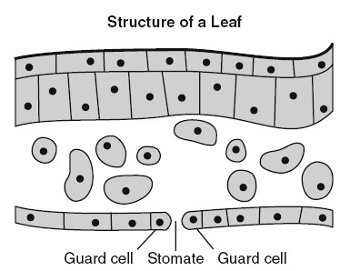
What structure is being shown here?
Stomate

Slide 8
What are the reactants of aerobic cellular respiration?
Oxygen and Glucose

Slide 9
Where is the energy stored in glucose, C₆H₁₂O₆?
The bonds between atoms

Slide 10
True or False: ATP is an organic molecule.
True

Slide 11
Which process in humans most likely accounts for the changes shown?
Oxygen level
CO₂ level
Concentration →
Time →
Time →
Respiration

Slide 12
What are the products of photosynthesis?
Glucose, Water and Oxygen

Slide 13
A stack of thylakoids is referred to as…
Granum

Slide 14
A green plant is kept in a brightly lit area for 48 hours. What will happen to glucose levels if the light is reduced during the next 48 hours?
It will decrease

Slide 15
Name an organism that solely uses anaerobic respiration.
Yeast/Some bacteria

Slide 16
What are the reactants of photosynthesis?
Carbon Dioxide, Water

Slide 17
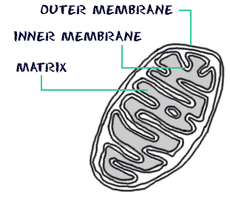
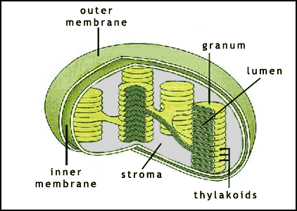
Diagram A Diagram B
A= Mitochonria
B= Cholorplast

Slide 18
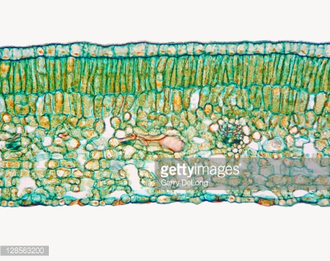
Most photosynthesis occurs in what part of the leaf?
Palisades Mesophyll/Layer

Slide 19
If a water plant is left in a capped test tube full of water for 48 hours, which gas should be expected to be collected from the tube?
Oxygen

Slide 20
What life process is most closely related with the opening and closing of guard cells?
Regulation

Slide 21
Which of the following organisms perform cellular respiration?
Algae
Plants
Animals
Fungi
Bacteria
Write all numbers that apply
1, 2, 3, 4, 5

Slide 22
Which of the following perform photosynthesis?
Algae
Plants
Animals
Fungi
Bacteria
Write down all numbers that apply
1, 2,
some 5

Slide 23
Another term for photosynthesis is…
Eukaryotic Nutrition
Prokaryotic Synthesis
Autotrophic nutrition
Heterotrophic nutrition
3) Autotrophic Nutrition

Slide 24
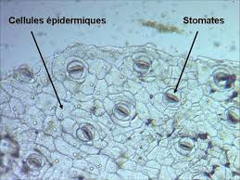
In what type of environment would stomates be closed?
Hot and Dry

Slide 25
Where do the following occur?
1) Glycolysis
2) Kreb’s Cycle
3) Electron transport chain
Cytoplasm
Matrix
Cristae

Slide 26
In what form do organic molecules enter the mitochondria?
Pyruvic Acid

Slide 27
Where does photolysis occur?
Grana/Thylakoid Discs

Slide 28
How many ATP are generated from glycolysis?
2

Slide 29
Which are associated with both respiration and photosynthesis?
Pyruvate
NADPH
ELECTRON TRANSPORT CHAIN
Matrix
Proton gradient
ATP Synthase
ATP
LUMEN
BCEFG

Slide 30
During the Light Reactions, Light helps split __________ into_____ and _______ ions…
Water
Oxygen
hydrogen

Slide 31
Because plants and algae can use the products of Respiration for Photosynthesis, and the products of Photosynthesis for Respiration, they are said to be…
Self-sustaining

