Slide 1
Tools of the Biologist

Slide 2
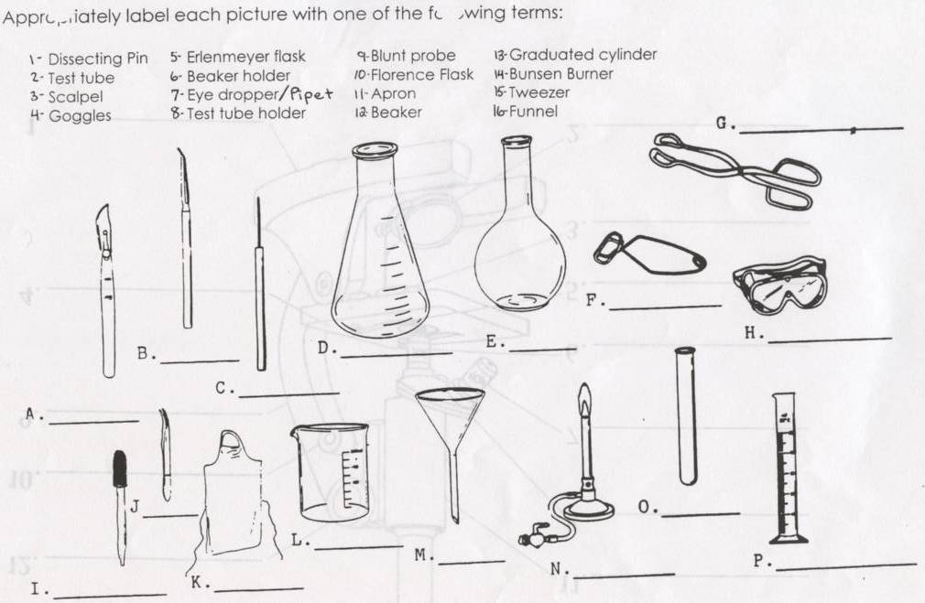

Slide 3
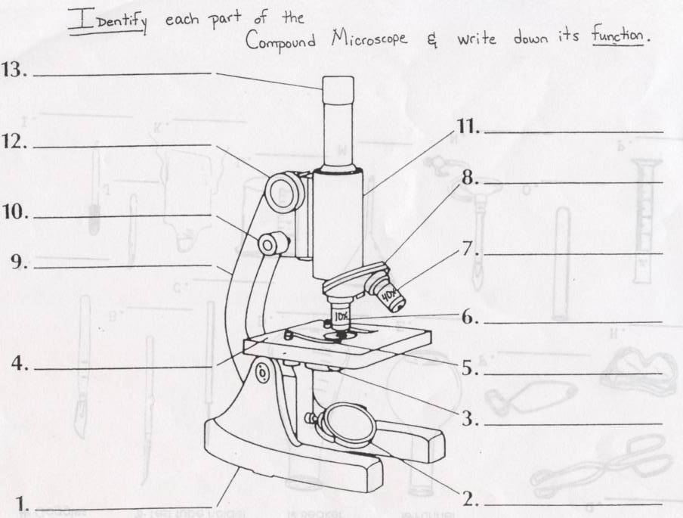
The Invention of the Microscope - YouTube

Slide 4
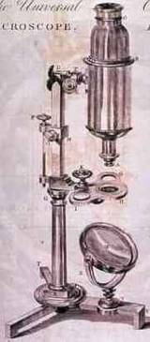
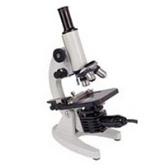
The Compound Light Microscope
One of the most important inventions in the field of biology because it led to the discovery of the CELL!!
In 1590 the first rudimentary microscope was developed,later perfected by Galileo and later Leeuwenhoek

Slide 5
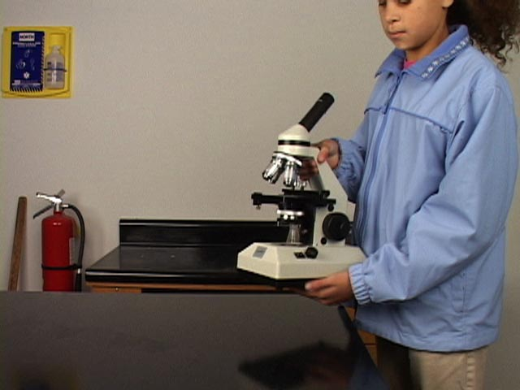
Microscope Safety and Care
carry with two hands (by arm and base)
Make sure the lenses and stage are clean before using (use lens paper)

Slide 6
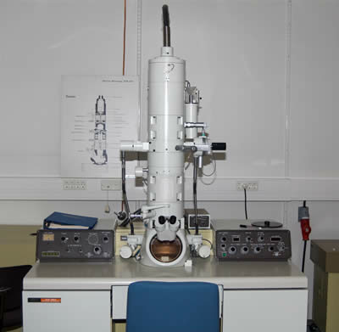
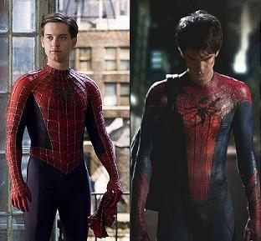
The Electron Microscope
Uses beams of electrons to magnify the image.
Living specimens cannot be observed.

Slide 7
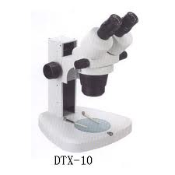
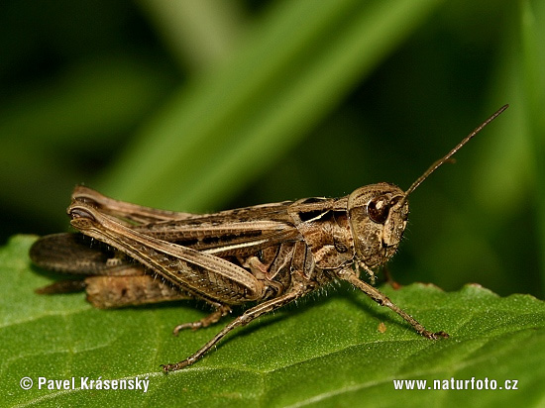
The Dissecting Microscope
Produces a 3-D image.
Useful for observing small organisms and body structure.

Slide 8
Slide Preparation
Specimen must be THIN for light to pass through
Stain may be needed to make organelles more visible
Coverslip should be placed at a 45 degree angle to avoid air bubbles
Making a Wet Mount for Microscopy - 1:20

Slide 9
Viewing a Slide
Always begin on the lowest available power (scanning)
Center specimen in the field of view (up is down, right is left)
Focus with coarse adjustment knob
Switch to low power and repeat #2 and #3
When using high power, focus only using the FINE adjustment to prevent losing sight of your specimen or damaging the slide!

Slide 10
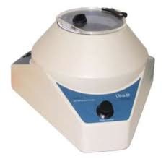
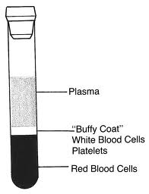
Ultracentrifuge
Separates the parts of a cell according to their density by whirling them in a test tube at a high speed.

Slide 11
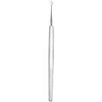
Microdissection Instruments
Can be used under the microscope for removal, addition, or transfer of cell parts.

Slide 12
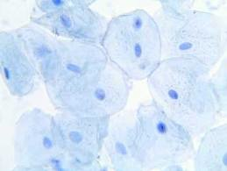
Staining
Structures in a cell can be made visible by using solutions which stain them. (Bromthymol Blue or Lugol’s iodine)

Slide 13
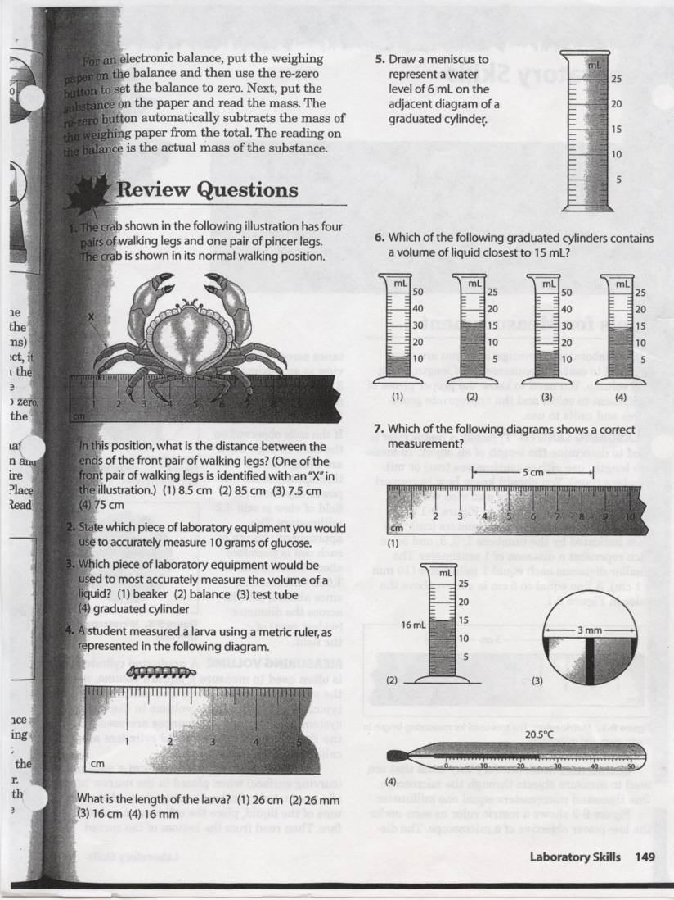

Slide 14
Of the following, which instrument is most commonly used to observe the external features of a grasshopper's abdomen?
1) ultracentrifuge
2) microdissection instrument
3) dissecting microscope
4) electron microscope

Slide 15
A student observed a Paramecium under the low power objective of a microscope (100x) and then under high power (400x). The image of the Paramecium under low power, compared to the image of the same Paramecium under high power, would be
1) smaller and in a darker field of view
2) smaller and in a brighter field of view
3) larger and in a darker field of view
4) larger and in a brighter field of view

